Slide 1
Decoding Secret Messages aND Gaussian ELIMINATION

Slide 2
Setup
Sending plain text messages encoded as binary strings
Have 4 “Workers” on the receiving end. We don’t trust some of them to handle the information alone. We have 1 reliable manager and 3 we are not as sure about.
We will split the message into 3 garbled binary strings; Any 2 of the 3 junior people together will be able to quickly decode the string, but a single person will not be able to do it (at least not very fast.) In particular, every person will be missing half the data.
The Manager will be the only one in possession of the character map.
Worker1
Preprocess
Decode
Manager Translates
Compose Message
Garbled Binary
Worker 2
Preprocess
Worker 3
Preprocess
Got
Drunk

Slide 3
Our Alphabet
Suppose we have 128 character alphabet (with some repeated characters), that covers the entire alpha-numeric spectrum and has a the important punctuation symbols and $+-&, etc.
7 Bits required, but we will use a 12 bit system to allow for using many different strings for the same character.
Meaning: Every symbol in our alphabet will have at least 32 different 12-bit representations. Some common items like “e” or “space”, will have 128 different representations.
So for example, “a” might be represented by different strings such as
0101 0111 0011 or 1101 0011 1110 , etc.

Slide 4
Composing the Message: “I hate Math 374!”
Char | Choose 12 bit string at random (selected from all possibilities for that char) | Scramble the String Before sending to minions
I | 1110 0001 1011 | 1000 1111 1010
Space | 1101 0101 1000 | 0111 0010 1111
h | 0100 1100 0010 | 1111 1011 1111
a | 0001 1111 0100 | 0100 0100 1011
t | 1011 1101 0001 | 0011 1001 1011
e | 1010 1111 1010 | 0011 0101 0100
Space | 0100 1100 1100 | 1001 1010 1000
m | 1111 1100 1000 | 0100 0011 1000
a | 1001 1111 0100 | 0010 1011 0100
t | 1010 1101 0001 | 0001 0101 1110
h | 1101 0100 0010 | 1110 0011 1110
Space | 0111 1001 1101 | 1101 0100 0000
3 | 0101 1011 0011 | 0110 0110 1010
7 | 1001 1011 1000 | 0101 0000 1001
4 | 1110 1011 0100 | 0011 0000 0000
! | 0001 0000 0000 | 1011 1000 1100

Slide 5
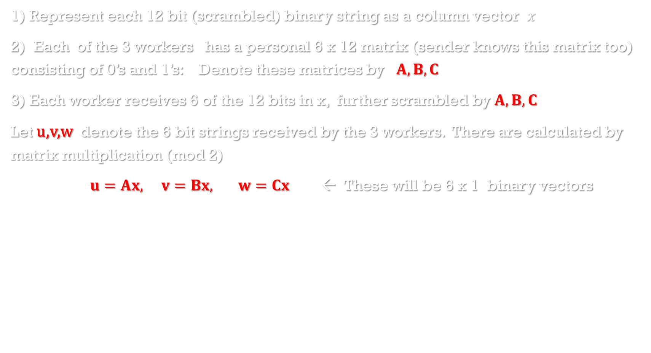
Sending the Bits to the workers
1) Represent each 12 bit (scrambled) binary string as a column vector $x$
2) Each of the 3 workers has a personal 6 x 12 matrix (sender knows this matrix too) consisting of 0’s and 1’s: Denote these matrices by $A, B, C$
3) Each worker receives 6 of the 12 bits in x, further scrambled by $A, B, C$
Let u,v,w denote the 6 bit strings received by the 3 workers. There are calculated by matrix multiplication (mod 2)
$u=Ax, v=Bx, w=Cx$ ← These will be 6 x 1 binary vectors
Each worker will get their data as series of 6 bit strings padded with some random garbage bits:
For Example:
Worker #1’s True Bits: 001101 would be Disguised As: 001101xxxxxxxxxx
See Rules on next page

Slide 6
Worker PreProcEssIng
Worker #1: Receives 16 bit packets; Extracts first 6, discards last 10
Organizes Bits in 2D array:
Worker #2: Receives 24 bit packets: Selects bits 3,5,7,11,13,17;
Worker #3: Receives 12 bit packets; Selects bits 2,4,6,8,10,12
For simplicity, each workers 2D array when done will have 6 rows and the same number of columns.

Slide 7
DeCoding The MESSAGE
Each Worker has a 6 x 12 matrix, and their message data organized into 6 x N matrix
How to Decode: If worker 2 got drunk and failed to show up, then workers 1,3
would “stack” their matrices and their data (store as M, b, respectively)
Worker | Matrix | Message Data
1 | A | u
2 | B | v
3 | C | w
M is 12 x 12; b is 12 x N

Slide 8
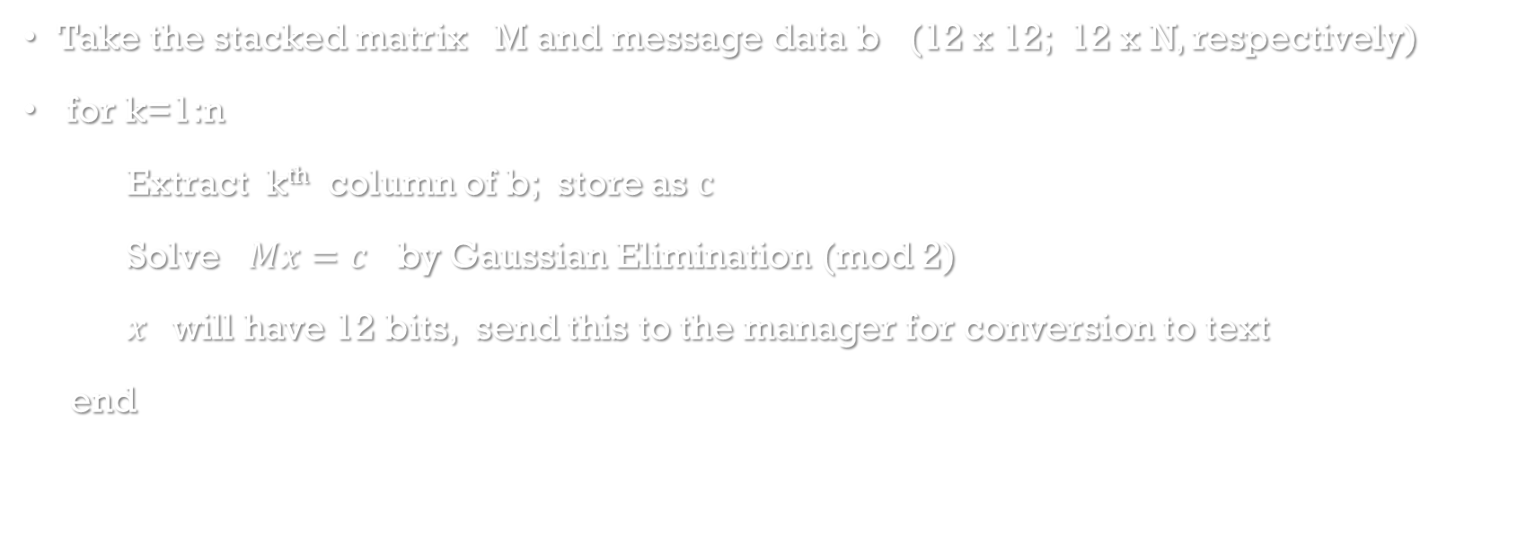
GAUSSIAN ELIMINATION TO THE RESCUE
Take the stacked matrix M and message data b (12 x 12; 12 x N, respectively)
for k=1:n
Extract k^{th} column of b; store as $c$
Solve $Mx=c$ by Gaussian Elimination (mod 2)
$x$will have 12 bits, send this to the manager for conversion to text
end

Slide 9
For the Assignnment
I will 3 text files with encoded binary strings (one for each worker)
You will: Preprocess the strings
Decode in the manner described on the last slide;
Pass on the previously prepared “bin2char” function, which will convert and print the results

